Slide 1
Scaled Digital Engineering addresses these trends
Transform Process & Experience
Develop Modern Applications & Platforms
Integrate Big Data Analytics

Slide 2
Digital Transformation needs focus on six core tenets
Design led
Leverage Design Thinking philosophy to deliver the right experience
API first
Identify capabilities needed in the platform and define APIs to enable them
Microservices based
Develop self-contained Microservices built for change and scalability
Insights infused
Data driven in-sights and built to support decisions based on data science
DevOps driven
Consistent process and automation to scale platforms across geographies
Web/Cloud scale
Deployment agnostic architecture; scale to accommodate across platforms

Slide 3
Modernization patterns
Extend
Legacy wrappers
API based wrappers
Single view of the data
Migrate
Tool assisted modernization
Microservices modernization
Integration, Middleware & Cloud migration
Transform
Leverage PaaS for transformation
Modern AD based transformation
EA-led process modernization

Slide 4
Prioritize modernization using the A-B-C approach
Build New Capability
Mobile
In-Store
Commerce
Marketing
Build
Care
Devices
Content / Usage
Optimization
ABSTRACTION
API Management
Event Processing
Activity Monitoring
Business Rules
Data Lake
Data Warehouse
E-Comm
Abstract
Optimize Existing IT
ESB
Workflow
EDI
ETL
Data Grids
Master Data
Reference Data
CHANGE
Enterprise Applications
Mainframe
PLM
CAD
MES
MRP
CRM
SLM
HR
Abstract: A layer to abstract complexities of Enterprise Applications through well defined APIs
Build: Develop new capabilities needed to service the Channel using the APIs
Change: Consolidate, update or replace applications in the back

Slide 5
Consulting & Engineering Overview
Consulting
Assessment & Migration Planning
Foundation & Landing Zone
Migration Factory
Setup &
Migration
Operations Support
& Program
Governance
Cloud/Integration Strategy formulation
Cloud/Integration Assessment
Finalize Business Case for Migration
Guiding Principle prioritization
Technology stack and standards finalization
Migration vs Cloud-Native Assessment & Architecture
Cost & Billing Analysis
International & Partner Alliances focus (NA, EU, Asia)
Assessment covering Application portfolio discovery, infrastructure mapping.
Migration planning covering move group planning, right sizing and migration plan ,target deployment architecture (migration execution , testing, data migration etc.).
Key Risk identification and Mitigation plan formulation
Transition of any existing footprint
Multi/Hybrid/Public/Private/Onprem/Barematel Landing Zone design alignment
Team resource on-boarding assistance
Foundation automation, build and testing using
Automation and IaC.
Setup
Migration factory setup
Migrate application hosted in Customer Datacenter to Public & Private Cloud using Industrialized approach for ‘Migration Factory’
Infrastructure based migration support leveraging “Lift+Shift” approach
Performing Testing (Smoke Testing) and Cutover in collaboration with Customer
Post migration activities (Runbooks, Learnings, DR/BCP drills)
Program Management
Program Governance
Budget Management/Business case realization
Risk management
Service Management and Processes
CloudOps
Command Center and Service Desk
DT ASM
Practice & Maturity Models
Strategy Document
Reference Architecture
Tools Portfolio
RFP Response, Bid Defense, SOW, MSA, NDA Collaterals
Legacy Modernization Patterns & Models
Business Case
Inventory Mapping
Move Group Recommendation
Migration/Testing plan
Decommission plan
Risk identification/mitigation plan
HLD/LLD for Hybrid Foundation
Automation artifacts for Foundation setup
Foundation setup for New Regions
Setup of Lift+Shift migration tools
Move group finalization
Migration POC
Interface Mapping
Migration/Testing execution using Factory model
Decommissioning of System and Database
Operations Runbook/SOPs creation
DevOps/CloudOps/CloudSecOps Architecture
Setup Automation framework toolset
Operations Steady State
Continuous Service Improvement
Key Deliverables

Slide 6
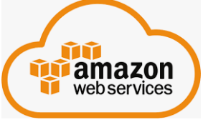




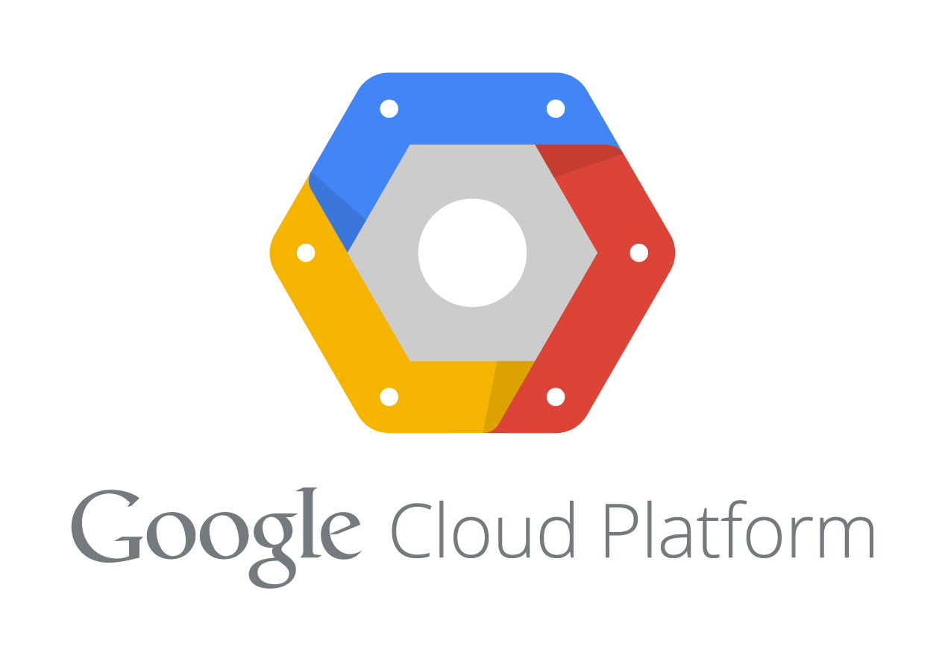


Sample Engagements Overview
S No | Client Name | Description of project | Migration Type |  | Target Cloud
 |  |  | Lift & Shift | PaaS Migration | Public | Private
1 | Large Financial Services Provider | Assessment, Planning, Remediation, Migration, Cloud-Native Development of Apps & Data platforms to Pivotal Cloud Foundry, Azure and AWS
2 | Large Telecom Service Provider | Assessment, Planning, Remediation, Migration and Integration of application to PCF and AWS cloud as well as CloudOps
3 | Large Clinical Trial Lab with M&A | Assessment, Planning, Remediation, Migration of 200+ workloads and Cloud-Native Development in Azure Azure PaaS Build, CRM in Force.com, Salesforce Apex/UI Migration of Data Platforms (Database, ETL, BI, DW)
4 | Leading provider of revenue cycle services | Cloud Blueprint, Architecture, Business Case Cloud Migration of landscape Integration with SaaS
5 | Leading Food Service | Digital Transformation – Cloud, DevOps, BigData, DataScience, APIs & Microservices
6 | Insights & Monetization Platforms | Building Digital & Data Platforms for Credit, Risk, Marketing, ID & Fraud |  |  |  | & Onprem Private Cloud
More Cloud engagements…
Simple Lift+Shift Migrations
IBM Cloud (zCloud, Bluemix, APIConnect, APIM)
RedHat OpenShift CaaS/PaaS
Salesforce Onprem CRM/Marketing Suite
Oracle Cloud for SOA & Apps
Several SaaS integrations in the Cloud, etc. (Fiorano API, ESB, SOA, MQ)

Slide 7
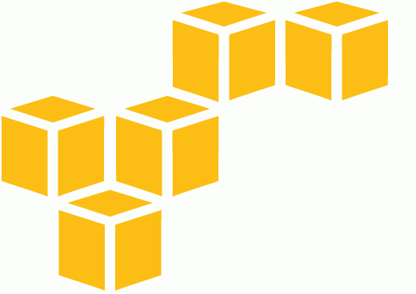

Reference Architecture
Platform Engineering –Re-Factor/Re-Architecture/Re-Build based on Microservices/ Serverless Architecture, Development & Testing, Performance Engineering
Business Application
Business Application
Business Application
REST APIs
Platform as a Service
API Management, Security, Metering, Billing
Enterprise Systems/ Device Integration
Microservices Framework
Cloud Ops
Containerization, Cloud Infra Provisioning, Deployment, Configuration, Testing, Roll-Out & Operations Support
Service Discovery
Dynamic Routing
Cloud Configuration
Big Data & Analytics
Message Broker
Business/Control Functions ( Microservices )
Security
AI/Machine Learning
Monitoring
Conceptual Architecture
Logging
Big Data, Analytics & Data Science
Data Modelling, Steam Data Ingestion and Data Lake Creation, Predictive Analytics AI/ML, Reporting
Cloudyn | Cost Explorer | Billing Calculator | Advisors
Caching
Central Data Lake
(Hadoop, Hana)
12 Factor App
Pattern based
Containerized
API enabled
Data Backing Services
API enablement, API management and value added business service enablement of legacy systems for new age extensions
Virtual Infrastructure
(Private / Public Cloud)
Data Science enabled
AI based
Performance instrumented
DevOps – CI/CD Pipeline Creation Deployment Automation
Enterprise Systems/ Devices
Enterprise System
Device
Enterprise Architecture | Solution Architecture | Application Architecture | Data Architecture | Business Architecture | Process Architecture | Infra + Ops Architecture | Governance

Slide 8



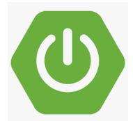


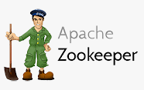



Integration Reference Architecture
Consumer
Functions
Merchant
App Entry
Edit Checks
Dup / Fraud
Pre Bureau Rules
Credit Bureau
Authentication
Decision
Fraud Master Strategy
Credit Master Strategy
IDA to 3rd Party
Data Share
Cloud / IaaS
Channel Apps
Mobile Apps
Browsers
BOTS
API Management Gateway
Mainframe Integration
Phone
Live Rep
Developer Portal
Swagger
Virtualization
Security
Metering
Throttling
Frontend / Cloud / PaaS
Webservice API
Web Apps
(.NET Core, Java/Tomcat, Nodejs)
SaaS Providers
Middleware / Cloud / PaaS
Workday
Salesforce
Middleware Business Systems
Workflow
Content Management
Decision Engine
IVR
SpringBoot/REST/Java Microservices
PaaS Providers
Oracle RAC
Distributed Messaging
ServiceNow
Splunk
Spring Kafka Integration
Kafka Cluster
Logstash
ZooKeeper Cluster Management
Kafka Broker 1..N
(Topic 1..N) (Partition 1..N)
ETL
ETL
Data
Partner Platforms & Apps
Enterprise Data
Data Stores
Database
Filesystem
Warehouse
. . .
Widgets
STS
API
Security API
EDL API
Data Lake
Information Security
Gemfire
Cache
Forensics
Audit
Authentication
Authorization
Encryption
Tokenization
Infrastructure / IaaS / IaC
API | CF/Azure/AWS/GCP CLI | SSH | Bosh | Bash | PowerShell
Network
Compute
Storage
Database
EUC
Private | Public | Hybrid

Slide 9
Big Data, Analytics & Data Science Reference Architecture
Data Marts
Split Datasets
Contributors
Historical Data
Analysts
Training
Results
Not optimal for holistic analytics
Feature
Engineering
Improved engagement
Data Warehouses
Optimal
Sources
Systems
Validation
Results
Hyperparameter tuning
Long cycle times – drive insights/build models
Predictive analytics
Lack of insight – full customer/trans behavior
Hold-out/A|B
Models
High complexity – data storage/governance
Machine Learning Process & Statistics Models
Sources
Environments
ZooKeeper
OLTP
Development
Tests
POC
Production
DR/BC
STORM
Mainframe/ Midrange
Lucene | Solr
OLAP
Systems (SOR/SOE)
Exploration…Clean, Trusted Data
Hadoop MR
Mahout
Hawq | Hive
Pig | Scripts
Exchanges
ETL
Flume Kafka Sqoop
Data Quality
Hadoop HDFS
Analysts & Data Scientists
Hadoop YARN
Contributors
HMA
Data Catalog
Model development, Machine learning, Portfolio analytics, Measurements, insights & monetization
Need for flexible BigData/AA/AI platforms
Spark
Streaming | SQL | MLlib | GraphX
Filesystem/ Logs
Data Security
HTAP
Structured & Unstructured Data
Analytics Zone
Anaconda Enterprise / Tableau / Power BI / Jupyter / Zeppelin /
HBase
Hue (SQL Editor / Visualizer)
Cassandra | Aerospike | MongoDB | HDP
Data Science enabled – ML at scale, NLP, CS, DL, NN
Perform computations at scale, operate in parallel massively
Challenges: Managing cluster membership, coordinating resource sharing, scheduling node tasks
Ability to support newer tech/opensource, simplify DW/DM
Fault tolerant, easily scalable, efficient processing larger datasets, resource pooling, high availability
Develop richer models/insights
Complex setup/better outcome: Nodes/Cores: 32/32 Memory/Storage: 6TB/2.5PB

Slide 10


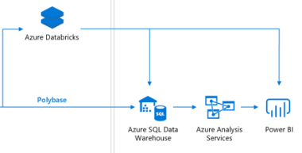


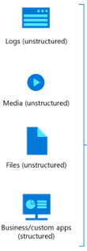

















Cloud/Azure Reference Architecture
Users
Web & Middleware
Data Platform
(.NET Core 2.2., Angular 5)
a) Advanced analytics on big data
Internal
b) Modern data warehouse
Workstation
Service Bus
REST Ops
External Requests
d) Machine learning & cognitive
REST
HDInsight
Apache Zeppelin | VS Code | U-SQL | JDBC
External
REST Sync
Transaction/Config/Log/File/Image
c) Real-time analytics
Apache Ranger | AD | Virtual Network
Workstation
REST Config
REST
Onprem
External
Mobile App
IaaS | PaaS | SaaS | DaaS | CaaS are structured according to the Network, Storage, Compute, Offering requirements (R, AS, VDC, VNet, Peering, LB, Security, AD, ADFS, IAM, VMs, Containers, GPUs, etc.)

